Slide 1
DIGITAL DIARY
Looking for digitize future
Presented by-
Ashutosh Prasad

Slide 2

INTRODUCTION To PROJECT
Basically an E-Diary, which is used to record personal events and experiences online. Instead of use a traditional diary or notebook to express your thoughts and feelings, use this E-diary .User has to create authenticated account and enjoy the services like saving personal contacts and images. This is secure because an authentication is required when user verified then they authorized to use the services.

Slide 3
OBJECTIVES OF PROJECT
“a physical diary can’t fit in pocket. But, a digital diary will.”
Easy to Organize
Daily Work
Personal Data Store
Easy Writing Service
Simple to Use
No Age Restriction
Memorizing User Info

Slide 4
FEATURES Of PROJECT
SECURE
ACCESSIBLE
FAST AND RELIABLE
Make it secure for each and every user.
We make it as user friendly and easy accessible by users.
With the simple design(GUI), it loaded faster.

Slide 5
PROJECT BUILDING PROCESS
SIMPLE DESIGN
PROGRAMMING
DATABASE STORING

Slide 6
WHY DIGITAL DIARY REQUIRED?
Journaling by hand is simple, but you can lose or damage a journal.
You can journal any time, as long as you have your smartphone or computer.
With a pen, you can easily doodle, draw, add graphs, and the like, but all your journalling no backups, no replacements.
But DIGITAL DIARY provides features that your data remain in database as long as you cannot delete.

Slide 7
SCOPE OF PROJECT
ACCESSING
AVAILABILITY
PAPERLESS
FREE OF COST
Our website did not charge any cost from the users. Users are free to use our website.
Easy to use because it is simple designed for any age of user.
This website is available on internet so it use to carry and available everywhere.
User no longer need to carry the traditional notebook.

Slide 8
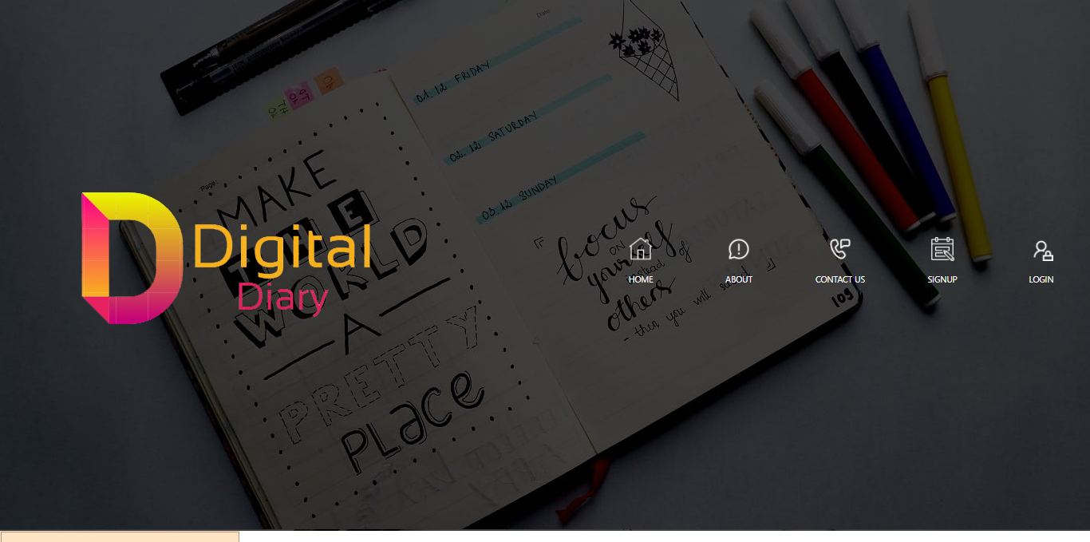
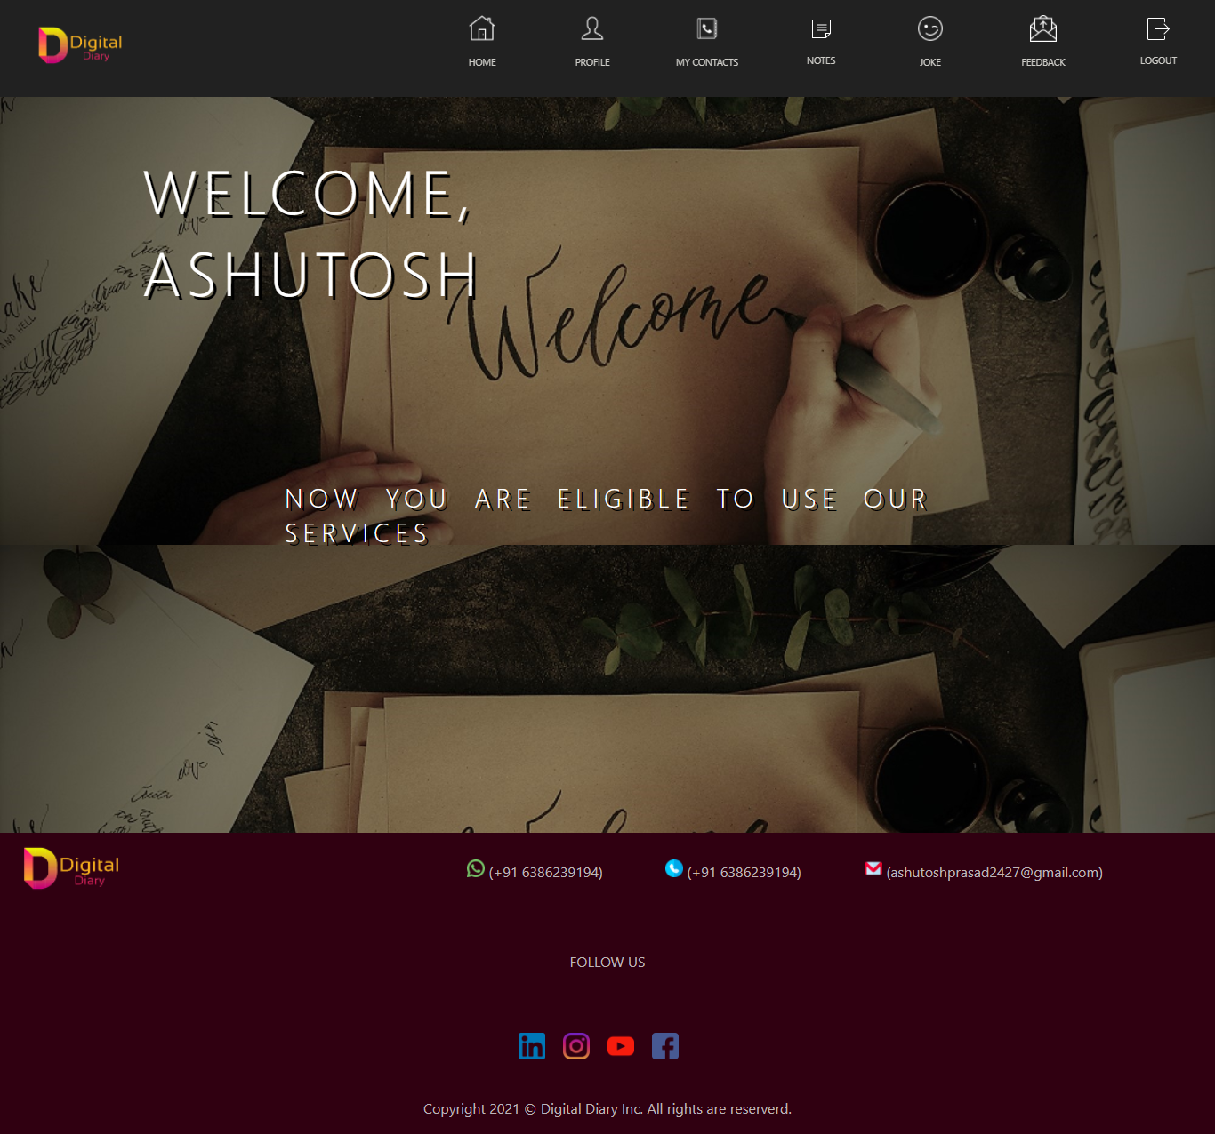
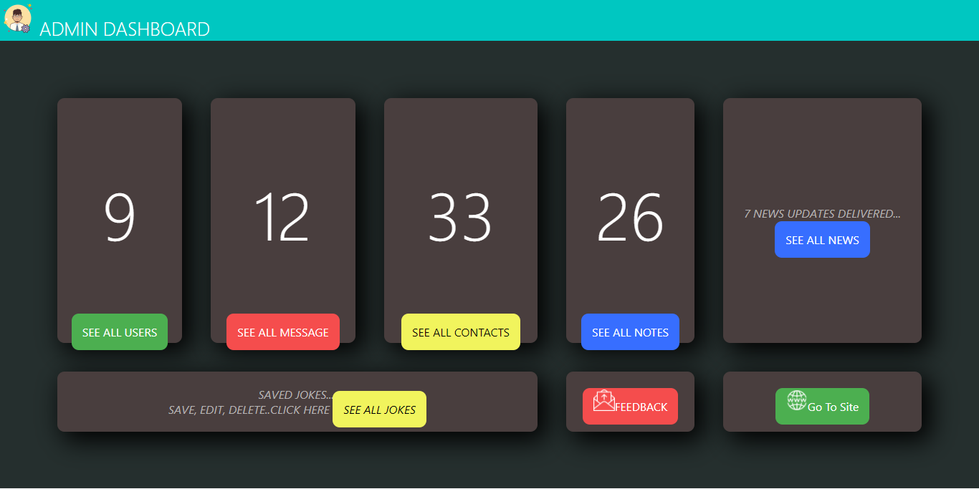
SNAPSHOT OF PROJECT
Main Portal
Administration Portal
User Portal

Slide 9
CONCLUSION
With Digital Diary’s online diary software, you can jot down things from your office computer, as well as your personal one, without missing a beat..
The website and app work in tandem through the digital journal software, allowing you to access your personal diary seamlessly on both.
This project aims to build a system which will help users to personalized and permanently store their data in an online journal platform.
We looking for new features in order to help users to enhanced their data personalization and accessibility on this project.

Slide 10
THANK YOU

